Slide 1
Evolution, Governance and Business Rules of FAAC
Being paper presented at a capacity building workshop on understanding of financial management systems and operations in Nigeria for staff of Federal Ministry of Finance, Budget & National Planning held at Newton Hotel, 24, Alexandria Crescent, off Aminu kano, Wuse 11, Abuja on the 28th and 29th of April, 2021. By Abdulkarim Ozi Ibrahim
Deputy Director, Federation Account Department
Office of the Accountant- General of the Federation

Slide 2
Presentation Outline
Understanding the meaning of Federating States
Understanding the meaning of Fiscal Federalism
Establishment of OAGF
Evolution of the Department of Federation Account
Business Rule of Federation Account
Appraisal of Revenue inflows into the Federation Account from 2016- 2020
Challenges to inflows into the Federation Account
Suggested solution to improve inflows into Special Accounts
Conclusion.

Slide 3
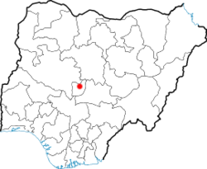
What is a Federation ?
MAP OF NIGERIA showing the 36 states and FCT
A Federation is a political entity characterized by a union or partially self governing states under a central Federal Government.

Slide 4
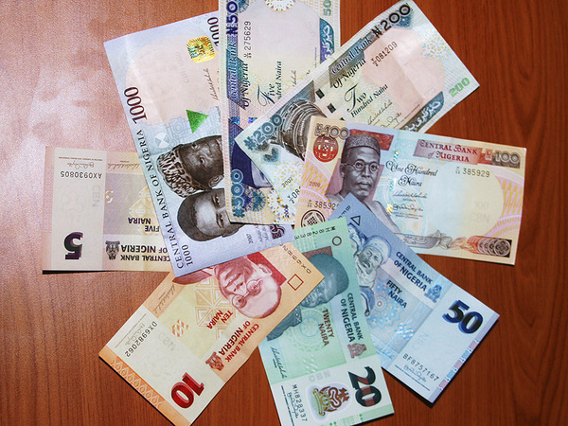
Understanding of Fiscal Federalism
Various denominations of Nigeria Currency on display
Fiscal Federalism means how Revenue and Expenditure of the Federation is Mobilized, Distributed and Utilized.
At the most basic level of Fiscal Federalism, attempts to define the division of governmental functions and the financial relationship between different level of government.

Slide 5
Establishment of OAGF
The Office of the Accountant-General of the federation (OAGF) was formally a department in the Federal Ministry of Finance.
In 1988 with the enactment of the Civil Service Re-Organisation Decree No 43, The Department became the Office of the Accountant-General of the Federation.
The Accountant-General of The Federation is the Chief Accounting Officer of Receipts and payments of the Government of the Federation.
The Office performs other financial services to the nation. We will however dwell only on the revenue related roles as follows:

Slide 6
OAGF Role in Revenue Matters
Carry out revenue monitoring and accounting
Revenue reconciliation
Manage Federal government investments through ministry of finance Incorporated (MOFI) Division.
Attendance of Annual General Meetings, Board Meetings.
Collection of Dividends and Director's Fees
Tax and customs refunds processing
Computation and collection of operating Surpluses.
Management of Special Accounts

Slide 7
Federation Account in perspective
FEDERATION ACCOUNT
NNPC
DPR
FIRS
NCS
MMSD

Slide 8
Revenue types generated by NNPC
Exports Crude Oil sales
Exports Gas sales
Domestic crude oil sales
Domestic gas sales

Slide 9
Revenue types generated by DPR
Royalty (Oil & Gas),
Concession Rental
Penalty on Gas flare
Miscellaneous Oil Revenue

Slide 10
Federation Revenue generated by FIRS
Company Income Tax (CIT)
Petroleum Profit Tax (PPT)
Value Added TAX (VAT)
Pay As You Earn (PAYE) Tax
Withholding Tax
Capital Gain Tax and
Others.

Slide 11
Federation Revenue Generated by NCS
Import Duty
Excise Duty
Value Added Tax (VAT) Foreign
FEES
Common External Tarif (CET) Levy
Others

Slide 12
FAAC Distribution cycle
FAAC meeting
Distribution of Revenue
Postmortem meeting
Sweeping of revenue to federation Acct.
FRRC meeting

Slide 13
Evolution of the Department of Federation Account in OAGF
The Federation Account Department is responsible for maintaining and disbursing accrued revenue into/from Federation Account in line with the formula and approved indices to the three tiers of government.

Slide 14
Evolution of the Department of Federation Account in OAGF cont’d
It is the only department saddled with the responsibility of performing the constitutional role of monitoring the accruals into and disbursement from the federation account as clearly stated under section 162(1-9) of 1991 constitution, Cap 15 of the laws of federal government of Nigeria, and section 1 of the financial Regulation.

Slide 15
Evolution of the Department of Federation Account in OAGF cont’d
The Department which shared similar historical existence with the mother Treasury Office was, formerly a division under the Funds department. The current Accountant-General of the Federation, Alhaji Ahmed Idris in his wisdom identified the need to obtain approval for the creation of new departments to meet up with the expansion in the treasury services for

Slide 16
Evolution of the Department of Federation Account in OAGF cont’d
efficiency and effectiveness which eventually resulted in the establishment of six departments in the treasury and eight revenue departments in MDAs. The process went through rigorous justification sessions with Office of the Head of civil Service of the federation finally, on 26th June 2018 culminated into the establishment of the brand new Federation Account Department.

Slide 17
Evolution of the Department of Federation Account in OAGF cont’d
The establishment has supported the need to have a one stop department for everything federation revenue, the on-going transformation of the treasury service for greater efficiency, transparency and accountability as enshrined in the Economic Reform and Governance Project (ERGP) and the drive to enhance and sustain the robust achievements in the public financial management reforms

Slide 18
Business Rules of Federation Account
The Federation Account is an account that is operated and maintained by the Accountant General of the Federation (AGF) but guided by the provisions of the Constitution and Laws of the Federation.

Slide 19
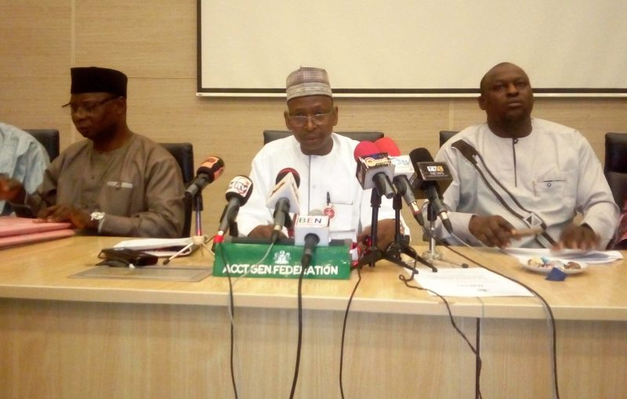
Business Rules of Federation Account Cont’d
FAAC MEETING
Section 162(1) of the 1999 Constitution of the Federal Republic of Nigeria; states that the Federation shall maintain a special account to be called “the Federation Account” into which shall be paid all revenues collected by the Government of the Federation, except the proceeds from the personal income tax of the personnel of the Armed Forces of the federation, the Nigeria Police Force, the Ministry or Department charged with responsibility of Foreign Affairs and the residents of the Federal Capital Territory.

Slide 20
Business Rules of Federation Account Cont’d
The same constitution in section 162(3) further states that any amount standing to the credit of the Federation Account, less the sum equivalent to 13 per cent of the revenue accruing to the Federation Account directly from any natural resources as a first line charge for distribution to the beneficiaries of the derivation funds in accordance with the Constitution.

Slide 21
Business Rules of Federation Account Cont’d
shall be distributed among the Federal, States and Local Government Councils in such terms and in such manner as may be prescribed by the National Assembly. The provisions of the Constitution were further explained by the Allocation of Revenue [Federation Account] Cap A 15 LFN. Section 1 of the Act states that; An Act to prescribe the basis for distribution of revenue accruing into the Federation Account between the Federal and State Governments and the Local Government Councils in the States

Slide 22
Business Rules of Federation Account Cont’d
the formula for distribution amongst the states inter se; the proportion of the total revenue of each state to be contributed to the state joint local Government Account; and for other purposes connected therewith: Section 6 of the Allocation of Revenue Cap A 15 LFN States; there is hereby established for the Federation a body to be known as the Federation Account Allocation Committee which shall comprise of the following members:

Slide 23
Business Rules of Federation Account Cont’d
Minister of Finance - Chairman
Commissioner for Finance of each State in the Federation
Two persons to be appointed by the President
The Accountant-General of the Federation.

Slide 24
Business Rules of Federation Account Cont’d
Functions of FAAC
to ensure that allocations made to the States from the Federation Account is promptly and fully paid.
to report annually to the National Assembly in respect of the function specified above.

Slide 25
Business Rules of Federation Account Cont’d
Formula for the Distribution of Revenue to the Three Tiers of Government
Since the Supreme Court ruling of 2002 and all the subsequent Modification Orders which came into effect in May, 2003 the Revenue sharing formula remains:
a. Vertical Distribution:
FGN 52.68%
States 26.72%
LGCs 20.60%
Total 100.00%
SHARING PROCESS

Slide 26
Business Rules of Federation Account Cont’d
Sharing process cont’d
The Federal Government’s share is further distributed as follows:
Consolidated Revenue Fund (CRF) 48.50%
Federal Capital Territory (FCT) 1.00%
Development of Natural Resources 1.68%
FGN Shares of Derivation and Ecology 1.00%
Stabilization 0.50%
Total 52.68%

Slide 27
Business Rules of Federation Account Cont’d
b. Horizontal Distribution:
In addition to Vertical Distribution, further distribution is made between the States and Local Government Councils using:
Equality,
Population,
Land Mass Terrain,
Social Development Factor and
Internal Revenue Effort, which is also known as Indices

Slide 28
Business Rules of Federation Account Cont’d
Indices:
Indices for distribution of Statutory Revenue Allocation are made between the States and Local Government Councils using:
Equality 40%
Population 30%
Land Mass and Terrain 10%
Social Development Factor 10%
Internal Revenue Effort 10%
13% Derivation:
13% Derivation is also used in the sharing formula to States where the mineral resources are sourced

Slide 29
The nine oil producing states in Nigeria are:
Abia
Akwa Ibom
Bayelsa
Delta
Edo
Imo
Lagos
Ondo
Rivers

Slide 30
Business Rules of Federation Account Cont’d
d. Excess Crude Savings Account:
The Excess Crude Savings Account (ECA) was created to warehouse excess of oil revenues over the pre-determined budgeted benchmark price of crude. The policy is in line with the Fiscal Responsibility of Government in managing the economy as one entity. However, over the years, there has been argument as to the desirability of this Account.
This is because some said that the Constitution provides that all federally collected revenues be paid into the Federation Account and should be shared to the three tiers of government namely; the Federal, States and Local Governments.

Slide 31
Business Rules of Federation Account Cont’d
Tax is not a burden but a duty that must be done
e. Value Added Tax:
Value Added Tax (VAT) Account is an account opened with Central Bank of Nigeria which warehouses VAT on both imported and non-imported goods and the accrued revenue is distributed monthly in line with the Allocation formula and indices provided by RMAFC and FIRS respectively. This is shared to the three tiers of Government as follows
f. Vertical Distribution:
Federal Government 15%
State Government 50%
Local Government 35%
Total 100%

Slide 32
Business Rules of Federation Account Cont’d
The Federal Government’s share is further distributed as follows:
Consolidated Revenue Fund (CRF) 14.00%
Federal Capital Territory (FCT) 1.00%
Total 15.00%
Horizontal Distribution:
In addition to Vertical Distribution, further distribution is made between the States and Local Government Councils using: Equality, Population and Derivation, which is also known as Indices.
Indices:
Indices for distribution of VAT Allocation are made between the States and Local Government Councils using:
Equality 50%
Population 30%
Derivation 20%
Pay your tax, avoid running

Slide 33
What is Federation Revenue
The Federal Republic of Nigeria operates a Financial System Structure where funds flow to the three Tiers of Government through an Account refers to as Federation Account. Any inflow of revenue belonging to the three tiers of government, is refers to as Federation Revenue.

Slide 34
Definition of Federation Revenue continued
Section 162(1) of the 1999 Constitution of the Federal Republic of Nigeria; states that the Federation shall maintain a special account to be called “the Federation Account” into which shall be paid all revenues collected by the Government of the Federation, except the proceeds from the personal income tax of the personnel of the Armed Forces of the Federation, the Nigeria Police Force, the Ministry or Department charged with responsibility of Foreign Affairs and the residents of the Federal Capital Territory.

Slide 35
What is Non-Federation Revenue
Non-Federation Revenue is any inflow of Revenue that does not belong to the three tiers of Government
That is, any revenue that is meant to be administered by the Federal Government of Nigeria only, with the exclusion of subnational Government.

Slide 36
Understanding Special Account
Special Accounts are revenue sources that derive their income from duties and taxes collected by the Nigeria Customs Service (NCS), Federal Inland Revenue Service (FIRS) and Department of Petroleum Resources (DPR) on behalf of benefiting Agencies

Slide 37
Understanding Special Account Con’t
These revenue have designated Special Accounts because they are ‘Intervention Funds’ meant to facilitate the speedy development of specific sectors of the economy

Slide 38
Understanding Special Account cont’d
due to their nature as intervention funds, Government decided to exclude them from the mainstream of National Budget so as to achieve their economic and developmental objectives more rapidly.

Slide 39
Mode of Establishment of Special Account
Mr. President signed an instrument tagged ‘Allocation of Revenue [Federation Account, etc., (Modification)] Order 2002’ deemed to have come into force on 29th May 1999. This Order stipulates a new formula for distributing revenue standing to the credit of Federation Account and as at date, the percentages are as stated below:
%
FGN: 52.68
States: 26.72
LGCs: 20.60

Slide 40
Categories of Special Accounts
Special Accounts that derive their funds from the Federation Account on monthly basis. Example of these are: Stabilization, Derivation & Ecology and Development of Natural Resources are managed by Federation Account.
Special Accounts that derive their revenue from duties and taxes collected. Examples of these are: Education Tax, Port Levy, Sugar Levy these are managed by Revenue & Investment Department.

Slide 41
Areas of intervention in pictures
For better understanding of the purpose for which special funds are meant, I have attempted to show you some photos. Have a look!

Slide 42
Revenue Sharing Formula to FGN, States & LG’s and FG Distributions
Federal Government – 52.68%
State Government – 26.72%
Local Government – 20.60%
The Federal Government share is distributed as follows:
CRF – 48.50%
FCT – 1.00%
FGN Development of Natural Resources – 1.68%
FGN Share of Derivation & Ecology – 1.00%, and
FGN Stabilization – 0.5%.

Slide 43
Appraisal of Revenue Inflows into the Federation
Account from 2016 to 2020
OFFICE OF THE ACCOUNTANT GENERAL OF THE FEDERATION
FEDERATION ACCOUNT DEPARTMENT
SUMMARY OF GROSS REVENUE GENERATED BY REVENUE GENERATING AGENCIES FROM 2016 TO 2020
DESCRIPTION | 2016 | 2017 | 2018 | 2019 | 2020
 | GROSS INFLOW | GROSS INFLOW | GROSS INFLOW | GROSS INFLOW | GROSS INFLOW
AGENCIES | =N= Billion | =N= Billion | =N= Billion | =N= Billion | =N= Billion
NNPC | 721.785 | 1,080.298 | 1,264.682 | 566.376 | 403.852
DPR | 424.473 | 733.044 | 1,246.477 | 1,603.047 | 1,404.615
FIRS - OIL | 1,136.876 | 1,402.360 | 2,491.974 | 2,122.658 | 1,536.979
FIRS - NON OIL | 1,107.476 | 1,251.458 | 1,426.243 | 1,639.082 | 1,473.843
NCS | 548.817 | 628.032 | 705.453 | 837.346 | 931.598
FIRS - VAT | 810.988 | 967.660 | 1,062.324 | 1,172.414 | 1,530.890
TOTAL | 4,793.160 | 6,147.607 | 8,287.891 | 8,073.748 | 7,414.602

Slide 45
Development of Natural Resources (1.68%)
Ownership | Purpose | Beneficiaries: | Disbursement:
This fund belongs to the three tiers of Government. | To provide financial resources to develop alternative natural resources to oil and gas. | Relevant Ministries such as MMSD, MWR&RD, MOA | National Economic Council (NEC). President grant final approval
Ownership, purpose and Institutional Mechanism for Disbursement

Slide 46
Derivation & Ecology (1.00%)
Ownership, purpose and Institutional Mechanism for Disbursement
Ownership | Purpose | Beneficiaries | Disbursement
FGN | To intervene in general ecology of the Country | States, National Emergency Management (NEMA) and National Agency for Great Green Wall (NAGGW) and recently NEDC | The National Committee on Ecological Problems (NCEP). The Committee has its office at SGF Ecological Funds Office

Slide 47
Stabilization Account (0.5%)
Ownership, purpose and Institutional Mechanism for Disbursement
Ownership | Purpose | Beneficiaries | Disbursement
3 Tiers | To provide for the rainy day especially during unforeseen contingences and economic down turn | FGN and States | National Economic Council (NEC). The final approval by the president

Slide 48
Excess Crude Account (ECA)
Ownership, purpose and Institutional Mechanism for Disbursement
Ownership | Purpose | Beneficiaries | Disbursement
3 Tiers | To save for the rainy day | The three tiers of government | Federation Account Allocation Committee (FAAC)

Slide 49
7% Port Development Surcharge
This levy is a charge to the import duties payable by all importers on importation of all dutiable goods into Nigeria. It is 7% of the free on Board (FOB) value of the import
.
Ownership | Purpose | Beneficiaries | Disbursement
Is held by the FG and maintained with CBN | It is used to help fund the dev. of facilities at sea ports, airports and agencies responsible for promotion and dev of export goods from Nig. | Nig. Ports Auth. (NPA), FAAN, Nig. Shippers Council. (NSC), RMRDC, Nig. Export Prom. Council. (NEPC), etc | A determined sharing ratio is applied approved by the Presidency, the HMF issues the AIEs then the AGF prepare mandate to CBN for the Acct to be credited.

Slide 50
5% Sugar Development Levy
Ownership | Purpose | Beneficiaries | Disbursement
Is held by the OAGF on behalf of the National Sugar Dev. Council. | It is used to help fund the development of local production of sugar in Nigeria, in order to discourage importation. | National sugar Development council, whose act specifies the levy as one of its sources of revenue. | NSDC applied to the presidency for approval. Upon approval the HMF issue the AIE, then AGF issue mandate to CBN
This levy is an additional charge on the import duties payable on the importation of sugar into Nigeria.

Slide 51
2% National Automotive Council Levy
This levy involves a charge of 2% of the cost, insurance and freight value of all imported fully built units (FBU), auto component spare parts, completely knocked down (CKD) and raw materials brought into Nigeria for the automotive sub-sector.
Ownership | Purpose | Beneficiaries | Disbursement
Is held by the OAGF on behalf of the National Automotive Council. | It is used to help fund the development of local production of motor vehicles in Nigeria. | National Automotive council. | NAC applied to the presidency for approval. Upon approval the HMF issue the AIE, then AGF issue mandate to CBN

Slide 52
0.5% ECOWAS Trade Liberalization Scheme
This is a levy on imports adopted by ECOWAS members counties including Nigeria in 1960, instituting a 0.5% tax on all produces imported from non-ECOWAS countries.
Ownership | Purpose | Beneficiaries | Disbursement
Its belong to ECOWAS members counties domiciled with Central Banks of members counties | It is used to encourage development of trade between counties in the ECOWAS trade group. | ECOWAS Secretariat in Abuja, Nigeria. | On application and approval by the ECOWAS secretariat, the AGF prepares a mandate for the CBN.

Slide 53
2% Education Trust Fund (ETF) now (TETFUND)
This is the 2% tax on the assessable profit of all companies registered in Nigeria.
Ownership | Purpose | Beneficiaries | Disbursement
This is held by the three ties of Govt. Federal, State and Local Govt. | It is used as intervention fund for the development of tertiary education facility in Nigeria. | Federal, State and Local Govt. tertiary educational institutions. | The board of trustees administers the tax imposed by the act and disburses the amount to the three tiers of Government Educational institution.

Slide 54
Challenges to Inflows into Special Accounts
Nigeria as a nation depends significantly on income from oil. The oil price, in addition to other commodities is determined by external factors beyond our control. Therefore, when the price is favorable the inflow goes up and when low the inflow goes down.
The production volume is another major determinant of the flow. Nigeria being an OPEC member is operating under ceiling imposed by the organisation. The volume is also determined by other factors as the market, security and the capacity of the International Oil Companies; ability to fund JVC.
The variation in the petroleum price/volume has a direct effect on the other revenue generation agencies particularly FIRS and DPR.

Slide 55
Challenges to inflows into Special Accounts cont’d
Illegal Bunkering of Crude Oil
Pipeline vandalism
Gas flaring
Joint Venture Cash Calls
Pipeline Maintenance
Delay in remittance

Slide 56
Challenges to inflows into special Accounts cont’d
Illegal Bunkering

Slide 57
Challenges of inflows into special Accounts cont’d
Pipeline Vandalism

Slide 58
Challenges of inflows into Special Accounts cont’d
Gas Flaring

Slide 59
Challenges of inflows into Special Accounts cont’d
Pipeline Maintenance

Slide 60
Challenges of inflows into Special Accounts cont’d
Delay in Remittance of Crude Oil Sales

Slide 61
SUGGESTED SOLUTIONS TO INFLOWS TO SPECIAL ACCOUNTS
Review of JVC agreements to conform to actual production and sharing;
Quick passage of the Petroleum Bill;
Diversification of Revenue Sources;
Review Customs tariffs, Export, Import and Excise duties;
Block Leakages

Slide 62
SUGGESTED SOLUTIONS TO INFLOWS INTO SPECIAL ACCOUNTS CONT’D
Expansion of Gas Sector
Development of other natural resources
Development of the Agricultural Sector
Avoid unnecessary waivers and Tax Holidays
Monitor Crude Oil production and lifting.

Slide 63
THANK YOU FOR LISTENING…

